Slide 1
Project on
LIBRARY
MANAGEMENT
SYSTEM
Submitted By:
Divyam Dogra
B.C.A. (IIIrd Year)
Roll Number: 12534

Slide 2
Contents…
Introduction
Purpose of Project
Hardware requirements
Software requirements
Data Flow Diagram
E-R Diagram
Screenshots
Limitations
Future enhancement
Conclusion

Slide 3
Introduction to Project
The project entitled “LIBRARY MANAGEMENT SYSTEM” is created for managing and meet out the requirements of a library. Specially, in this modern time, the computer is the most important that everyone want to apply in their general lives and business ventures. In the world of computers everything becomes fast. Computer plays a wide role in any organization. Nobody wants to spend maximum part of his precious time in Searching. The project “LIBRARY MANAGEMENT SYSTEM” is time saving and informatics application for every employee. This project will be capable of managing the various informations regarding issued book, returned book, book information and various other informations regarding the library. The main and fore most objective of this project is to provide facility for maintaining the details of LIBRARY.

Slide 4
Purpose of Project
The increasing courage of technology and computers can made any business venture to feel the requirement of such an application. As I said the application is capable of managing the various information regarding issued book, returned book, book information , it make the front office job very easy. It will require less efforts, less paper work and having less error prone. With a central database for every front office activity, the job will be easy without any hurdle.

Slide 5
Hardware Requirements
Processor: P4 or above (recommended)
Ram: 256 MB or above (recommended)
CPU Clock: 1.5GHz or Above
Printer: Standard office printer can be used

Slide 6
Software Requirements
Operating system: Windows 7
Front End: VB.NET 2005
Back End: MS-Access 2007

Slide 7
0 Level-Data Flow
Diagram
USER
Library
Management System
Books Management
Student Management
Issue Book
Student
Request Book
Issue Book
Return Book

Slide 8
1 Level-Data Flow Diagram
User
Book Management
Add Book
Book Related Data
Issue Book
confirmation
Issue Book
confirmation
Book Issued To Student
Book Related Data
Student
Return Book
Return Book
Return Book
Student

Slide 9
Entity Relationship Diagram
Student Name
Class
Student
Book Code
Student smartcardno
Issue &
Return
Book Code
Price
Book Name
Author
Books
Edition
Page No.
Subject

Slide 10
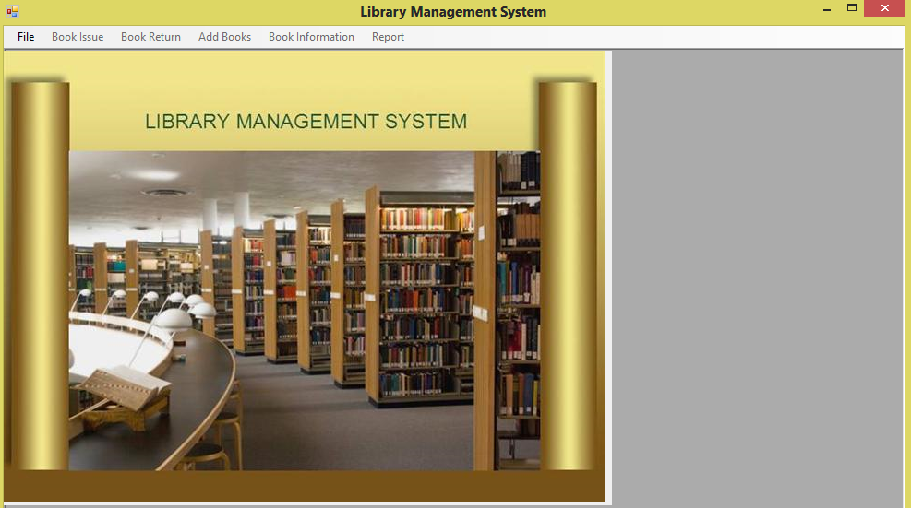
MDI Form…

Slide 11
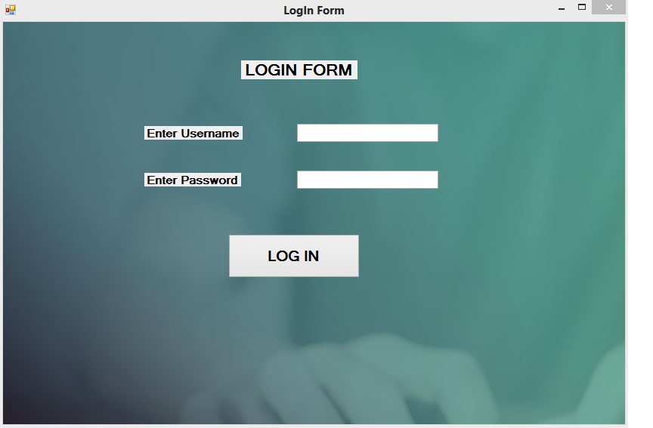
Log In Form…

Slide 12
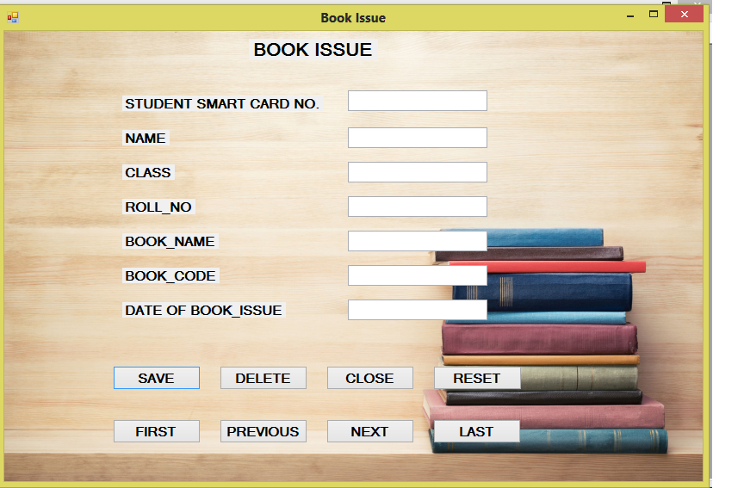
Book Issue…

Slide 13
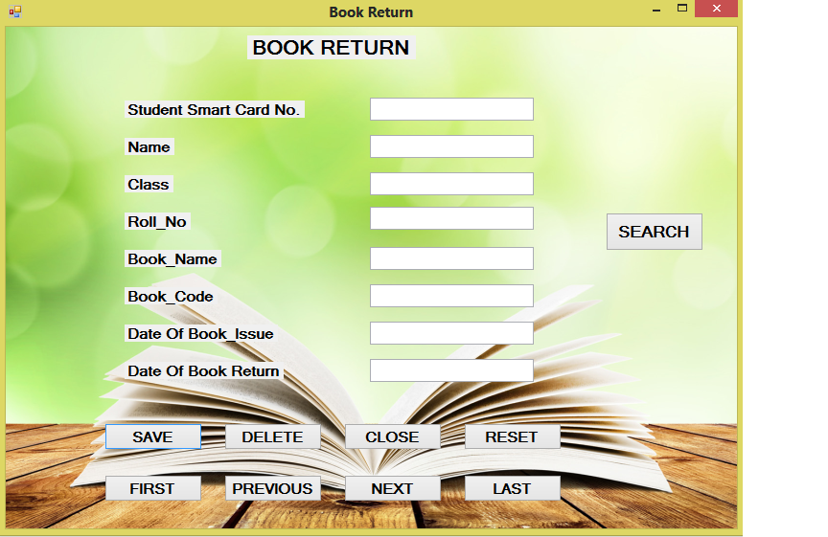
Book Return…

Slide 14
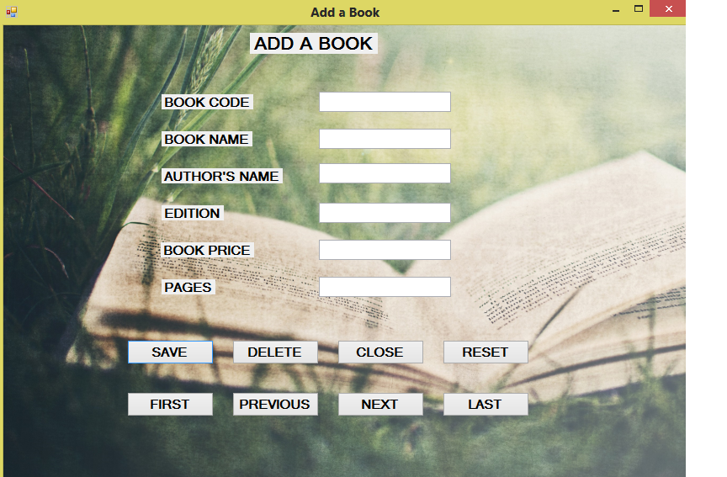
Add A Book…

Slide 15
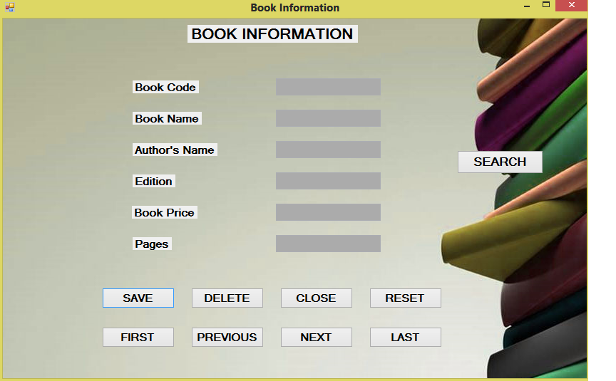
Book Information…

Slide 16
Limitations…
The project will not work if the s/w & h/w requirements are not fulfilled properly.
Report of particular student can’t be show.

Slide 17
Future Enhancements…
In the future , we can implement more security checks to make it more safe and secure. There could be a future scope for the project of adding additional functionality or modules for other tasks being performed at a library. A provision could be made to run the system on a distributed system/networking environment. Additionally there could be a module for showing the report of particular student.

Slide 18
Conclusion…
Presently the project is working properly and it is ready to be implemented. This project meant a lot for me because I have enjoyed the great experience of the project exposure and problem solving. Hence, I can say, the basic functionality of the project is achieved which includes:
1 Very fast access to data
2. User-friendly environment
3. Easy in searching records or any information
4. Less error prone
5. Time saving
6. Graphical User Interface

Slide 19
THANK YOU

